Slide 1




What’s Next for the Upcoming Apache Spark 4.0 Release?
Data + AI Summit 2024

Slide 2

























Major Features
GA
Apache Spark 4.0
Spark Connect
Python
ANSI Mode
Arrow optimized Python UDF
pandas 2 API parity
Structured Logging
[WIP] Variant Data Types
Python Data Source APIs
SQL UDF/UDTF [WIP]
SQL
applyInArrow DF.toArrow
Polymorphic Python UDTF
PySpark UDF Unified Profiling
UDF-level Dependency Control [WIP]
[WIP] Collation Support
[WIP] Stored Procedures
Execute Immediate
View Evolution
Streaming
More
Arbitrary Stateful Processing V2
State Data Source Reader
Streaming Python Data Sources
New Streaming Doc
Error Class Enhancements
XML
Connectors
Spark K8S operator
Java 21

Slide 3





New Functionalities
Spark Connect, ANSI Mode, Arbitrary Stateful Processing V2, Collation Support, Variant Data Types, pandas 2.x Support
Extensions
Python Data Source APIs, XML/Databricks Connectors and DSV2 Extension, Delta 4.0
Agenda
Custom Functions and Procedures
SQL UDFs, SQL Scripting, Python UDTF, Arrow optimized Python UDF, PySpark UDF Unified Profiler
Usability
Structured Logging Framework, Error Class Framework, Behavior Change Process

Slide 4
Spark Connect

Slide 5













How to embed Spark in applications?
Up until Spark 3.4: Hard to support today’s developer experience requirements
Applications
Spark’s Monolith Driver
SQL onLy
Modern data application
Application Logic
Analyzer
IDEs / Notebooks
CLose to REPL
Optimizer
Scheduler
Programming Languages / SDKs
Distributed Execution Engine
No JVM InterOp

Slide 6

Connect to Spark from Any App
Thin client, with full power of Apache Spark
Applications
Spark’s Driver
Spark Connect Client API
Modern data application
Application Gateway
Analyzer
IDEs / Notebooks
Optimizer
Scheduler
Programming Languages / SDKs
Distributed Execution Engine

Slide 7
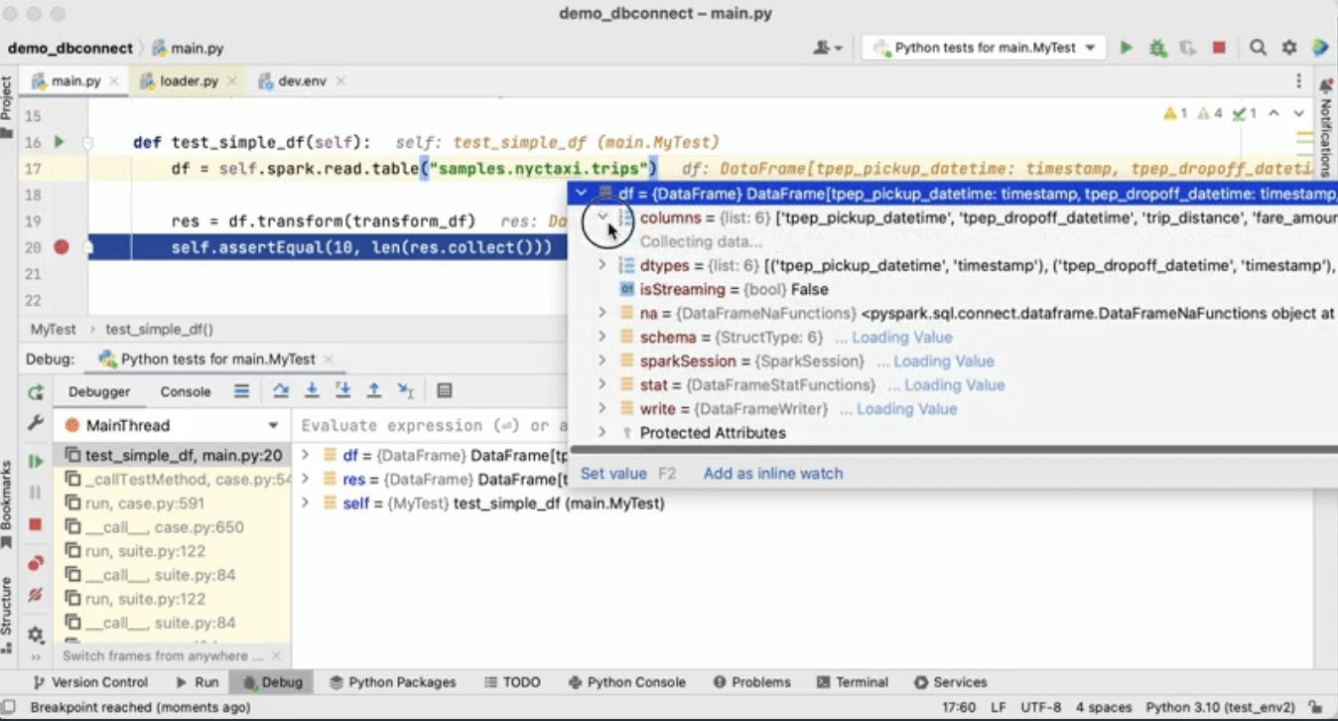

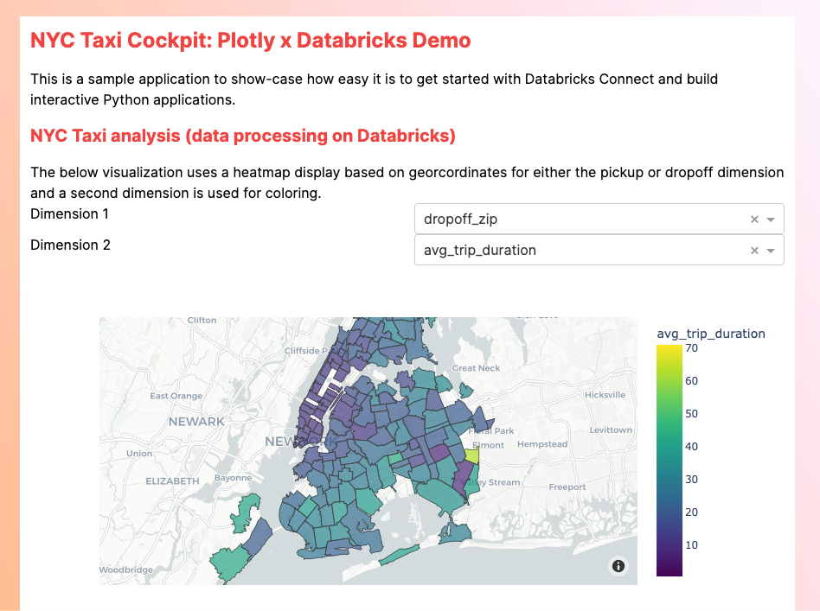




Spark Connect GA in Apache Spark 4.0
Interactively develop & debug from your IDE
New Connectors and SDKs in any language!
Build interactive Data Applications
Scala3
Databricks Connect
pip instaLL pyspark>=3.4.0
in your favorite IDE!
©2024 Databricks Inc. — All rights reserved
Check out Databricks Connect, use & contribute the Go client
Get started with our github example!
7

Slide 8
The lightweight Spark Connect Package
pip install pyspark-connect
Pure Python library, no JVM.
Pure Spark Connect client, not entire PySpark
Only 1.5MB (PySpark 355 MB)
Preferred if your application has fully migrated to the Spark Connect API.
©2024 Databricks Inc. — All rights reserved

Slide 9
ANSI MODE
ON by default in 4.0
©2024 Databricks Inc. — All rights reserved

Slide 10
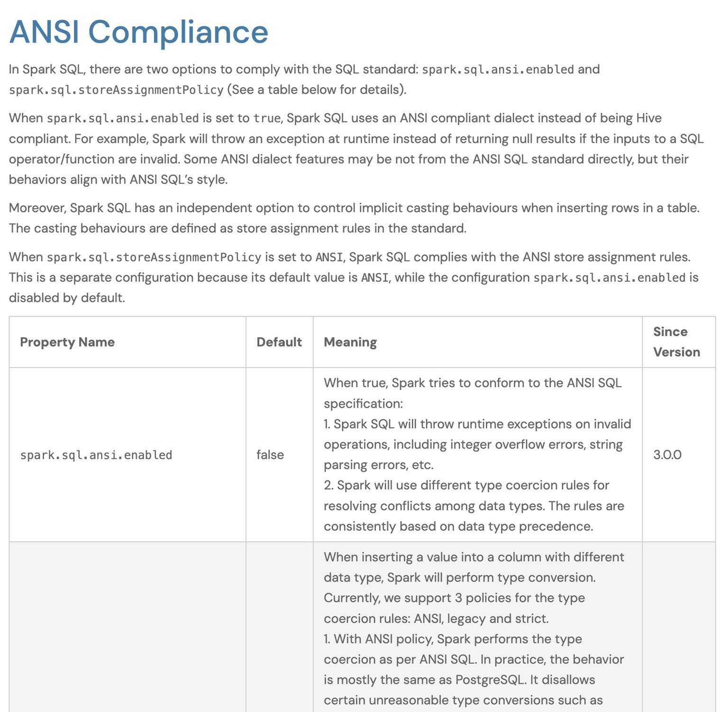
Migration to ANSI ON
Action: Turn On ANSI Mode to fix your data corruptions!
©2024 Databricks Inc. — All rights reserved

Slide 11

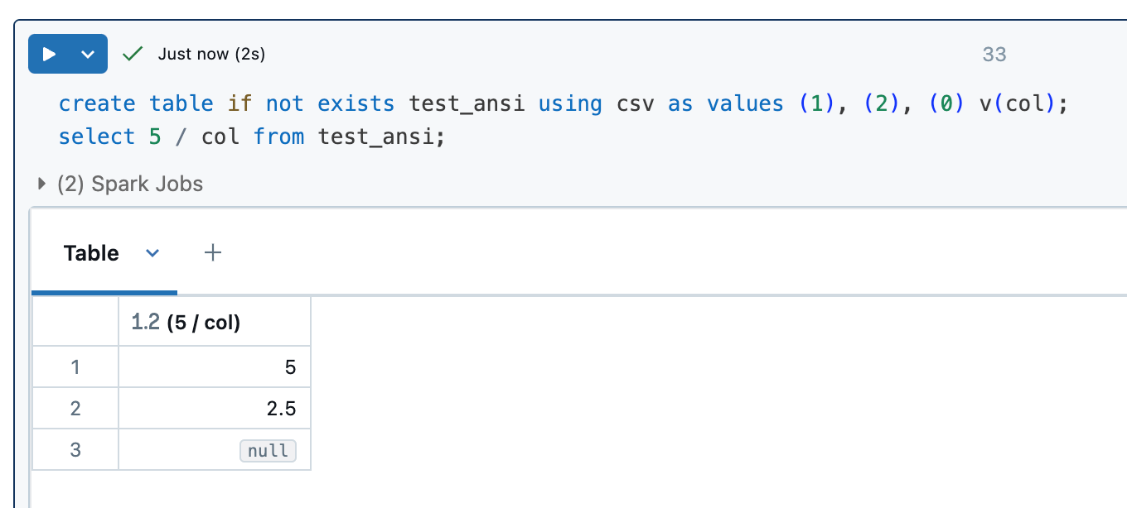
Without ANSI mode
Data Corruption!
©2024 Databricks Inc. — All rights reserved

Slide 12

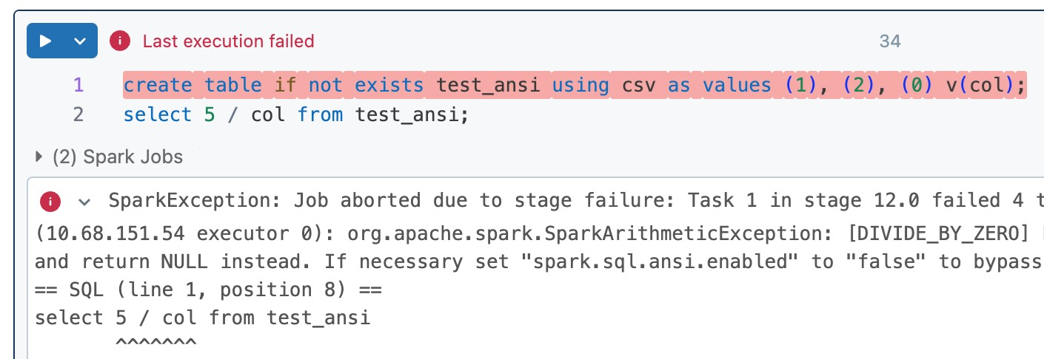
With ANSI mode (3.5)
Error callsite is captured
©2024 Databricks Inc. — All rights reserved

Slide 13

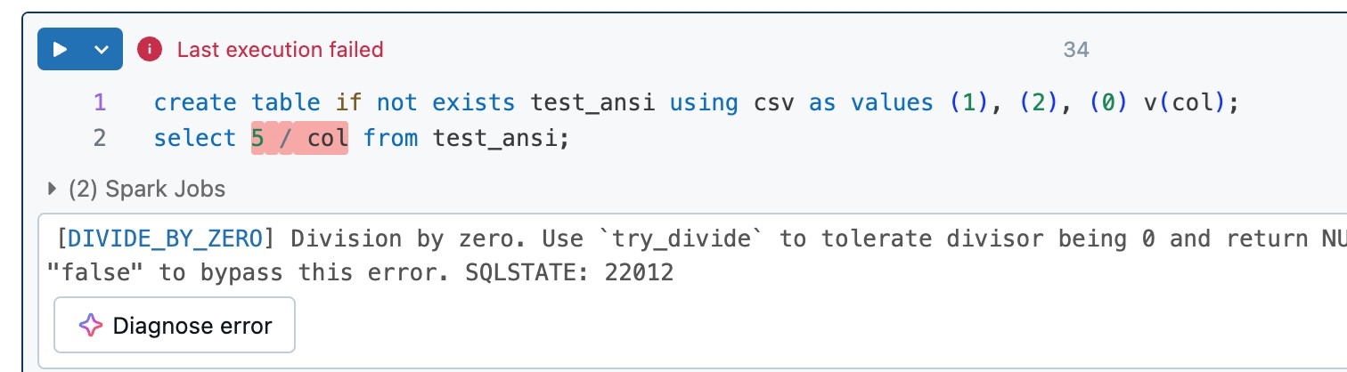
With ANSI mode (4.0)
Error callsite is highlighted
©2024 Databricks Inc. — All rights reserved

Slide 14

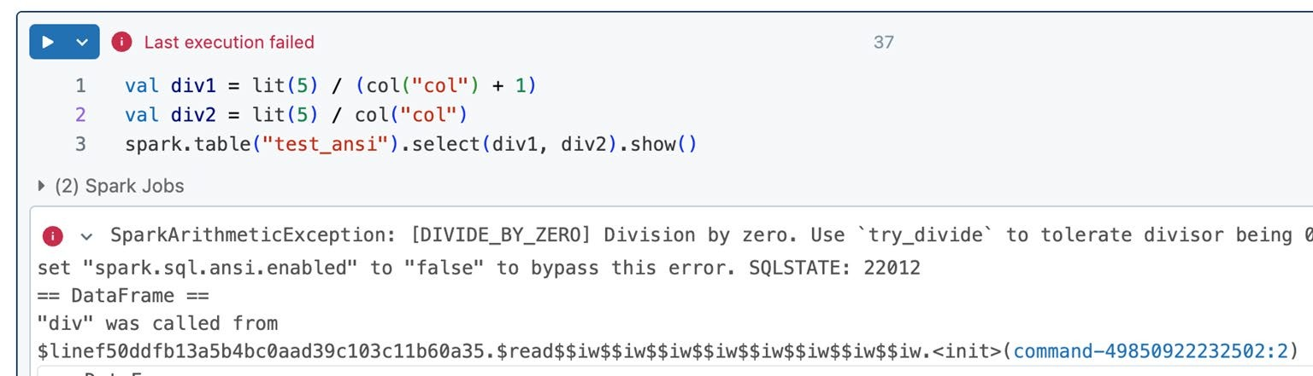
With ANSI mode (4.0)
DataFrame queries with error callsite
Culprit operation
Line number
©2024 Databricks Inc. — All rights reserved

Slide 15
DataFrame queries with error callsite
PySpark support is on the way.
Spark Connect support is on the way.
Native notebook integration is on the way (so that you can see highlight).
©2024 Databricks Inc. — All rights reserved

Slide 16
Variant Data Type for Semi- Structured Data
©2024 Databricks Inc. — All rights reserved

Slide 17
Motivation
Data Engineer’s Dilemma: Only pick 2 out of 3…
What if you could ingest JSON, maintain flexibility, boost performance, and use an open standard?
Flexible
Fast
Open
©2024 Databricks Inc. — All rights reserved

Slide 18
Variant is flexible
INSERT INTO variant_tbl (event_data) VALUES
SQL
(
PARSE_JSON(
'{"level": "warning", "message": "invalid request",
"user_agent": "Mozilla/5.0 ..."}'
)
);
SELECT
* FROM
variant_tbl WHERE
event_data:user_agent ilike '%Mozilla%';
©2024 Databricks Inc. — All rights reserved

Slide 19
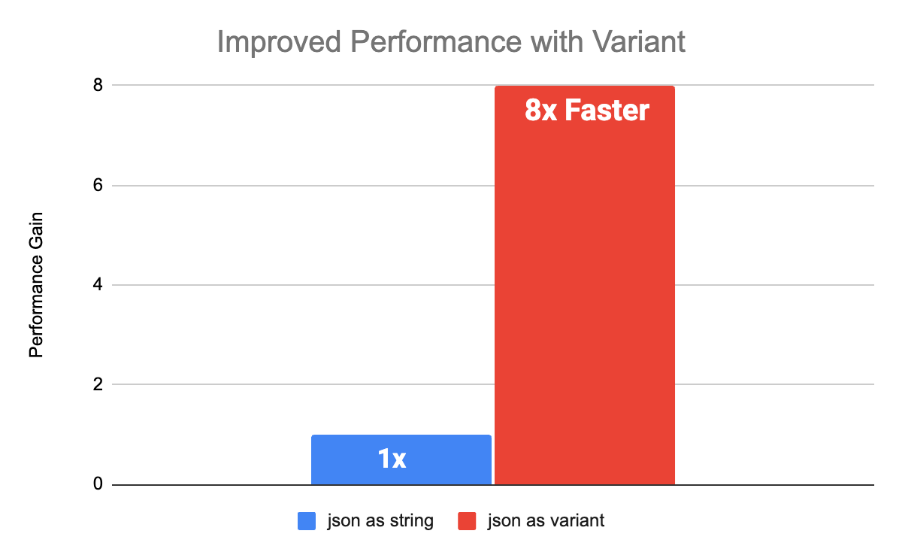
Performance
©2024 Databricks Inc. — All rights reserved

Slide 20
String Collation Support
©2024 Databricks Inc. — All rights reserved

Slide 21
ANSI SQL COLLATE
Sorting and comparing strings according to locale
Associate columns, fields, array elements with a collation of choice
Case insensitive
Accent insensitive
Locale aware
Supported by many string functions such as
lower()/upper()
substr()
locate()
like
GROUP BY, ORDER BY, comparisons, …
Supported by Delta and Photon
©2024 Databricks Inc. — All rights reserved

Slide 22
A look at the default collation
A < Z < a < z < Ā
SELECT name FROM names ORDER BY name; name
Anthony Bertha anthony bertha Ānthōnī
SQL
Is this really what we want here?
©2024 Databricks Inc. — All rights reserved

Slide 23
COLLATE UNICODE
One size, fits most
SELECT name FROM names
ORDER BY name COLLATE unicode;
name Ānthōnī anthony Anthony bertha Bertha
SQL
Root collation with decent sort order for most locales
©2024 Databricks Inc. — All rights reserved

Slide 24
COLLATE UNICODE_CI
Case insensitive comparisons have entered the chat
SELECT name FROM names
WHERE startswith(name COLLATE unicode_ci, 'a') ORDER BY name COLLATE unicode_ci;
name anthony Anthony
SQL
Case insensitive is not accent insensitive: We lost Ānthōnī
©2024 Databricks Inc. — All rights reserved

Slide 25
COLLATE UNICODE_CI_AI
Equality from a to Ź
SELECT name FROM names
WHERE startswith(name COLLATE unicode_ci_ai, 'a') ORDER BY name COLLATE unicode_ci_ai;
name Ānthōnī anthony Anthony
SQL
100s of supported predefined collations across many locales
©2024 Databricks Inc. — All rights reserved

Slide 26
Streaming State Data Source
©2024 Databricks Inc. — All rights reserved

Slide 27
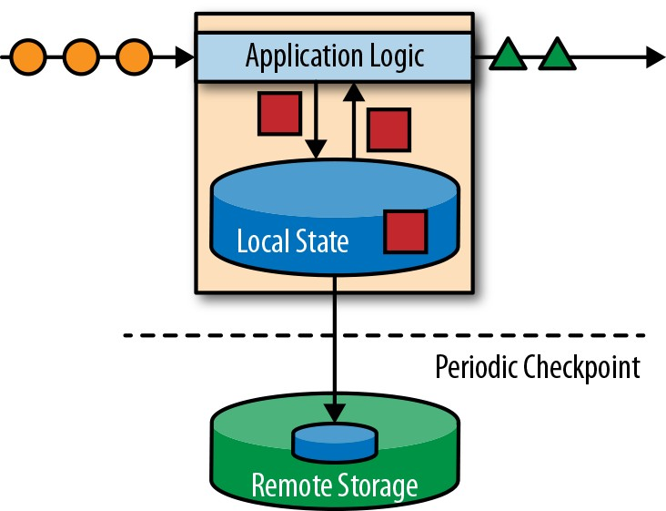
Stateful Stream Processing
©2024 Databricks Inc. — All rights reserved

Slide 28
Streaming State data source
Allows you to inspect the internal states of streaming applications, for debugging, profiling, testing, troubleshooting, etc.
Allows you to manipulate the internal states for quick workaround to recover urgent issues.
All with your familiar data source APIs.
©2024 Databricks Inc. — All rights reserved

Slide 29
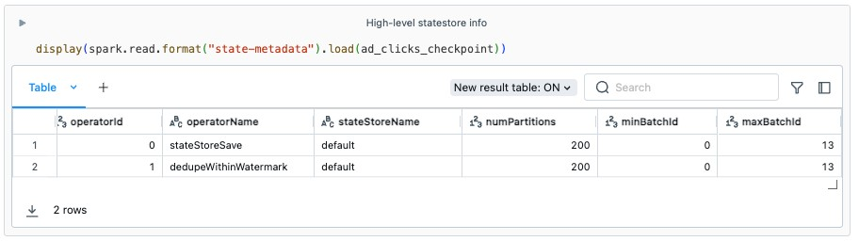
State Reader API: state-metadata
High-level API
©2024 Databricks Inc. — All rights reserved

Slide 30
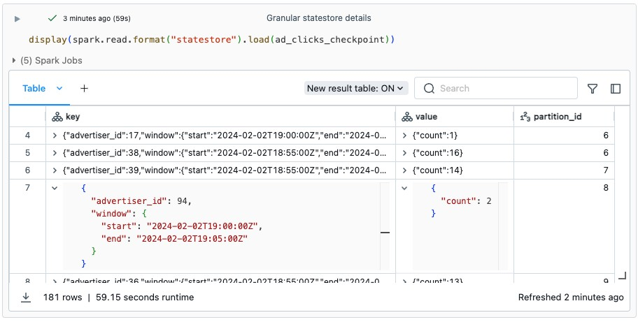
State Reader API: statestore
Granular API
©2024 Databricks Inc. — All rights reserved

Slide 31
Arbitrary Stateful Processing V2
©2024 Databricks Inc. — All rights reserved

Slide 32
(flat)MapGroupsWithState: current V1 version
Supports a single user defined state object per grouping key
State object can be updated while evaluating the current group, and updated value will be available in next trigger.
val ds = spark.readStream.json(path)
.as[CreditCardTransaction]
ds.groupByKey(_.cardId)
.flatMapGroupsWithState[ CreditCardTransactionState, CreditCardTransaction
](
OutputMode.Append(), GroupStateTimeout.NoTimeout())
(_, txns, groupState) => {
// read state, compute new average, and save to state
...
}
₎ Scala
(
©2024 Databricks Inc. — All rights reserved

Slide 33


Limitations of (flat)MapGroupsWithState
Lack of Data Modelling Flexibility
Prevents users from spLitting state (for a grouping key) into muLtipLe LogicaL instances, which can be read/updated independentLy.
Lack of Composite Types
VaLues stored in GroupState are singLe types and cannot support data structures Like List, Map etc efficientLy. Current approach requires users to read/update the entire data structure.
Lack of State Eviction Support
No support for eventuaL state cLeanup using TTL.
Lack of State Schema Evolution
Does not support changes to state schema once the streaming query has started.
©2024 Databricks Inc. — All rights reserved

Slide 34
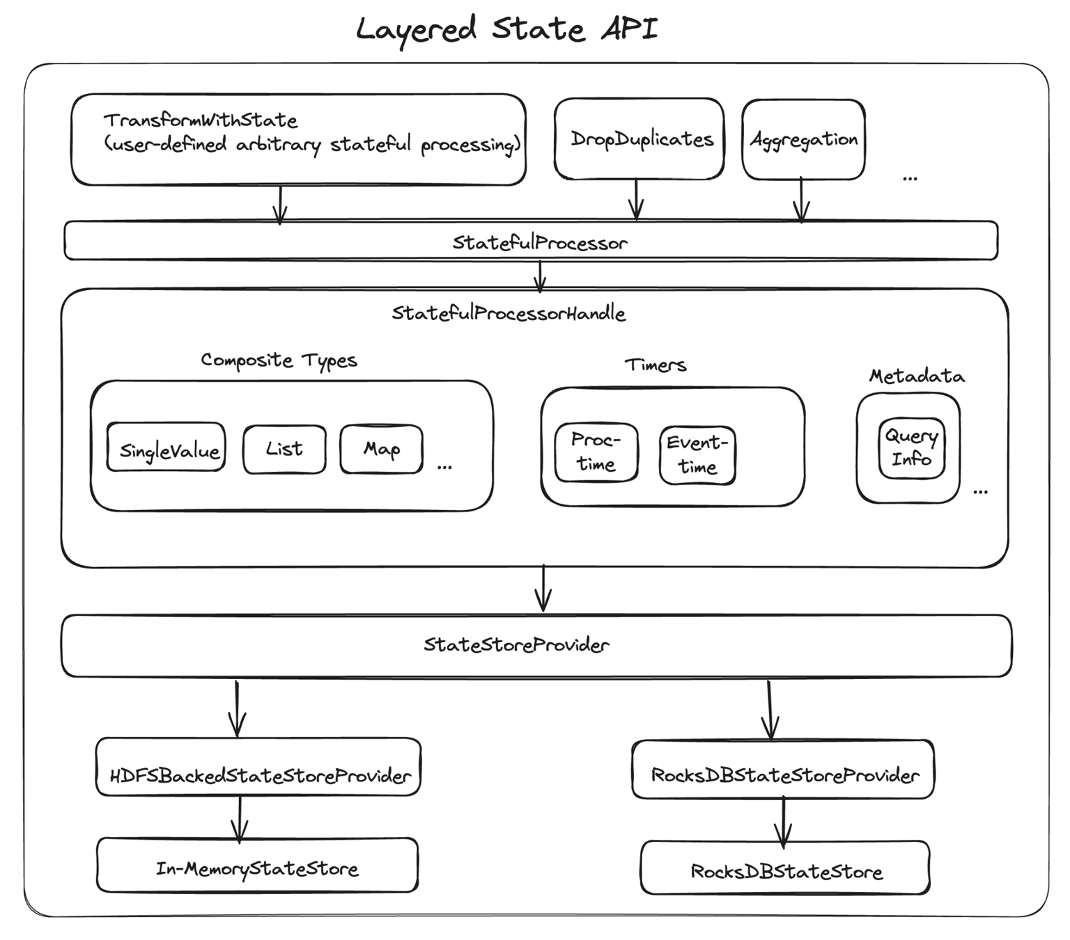
transformWithState: the V2 version
Layered, Flexible, Extensible State API
©2024 Databricks Inc. — All rights reserved

Slide 35
pandas 2 support/API parity
©2024 Databricks Inc. — All rights reserved

Slide 36
Pandas API on Spark (Koalas)
pandas
Pandas API on Spark
import pandas as pd
df = pd.read_csv("my_data.csv") df.columns = ['x', 'y', 'z1'] df['x2'] = df.x * df.x
import pyspark.pandas as ps
df = ps.read_csv("my_data.csv") df.columns = ['x', 'y', 'z1'] df['x2'] = df.x * df.x
Python
Python
©2024 Databricks Inc. — All rights reserved

Slide 37
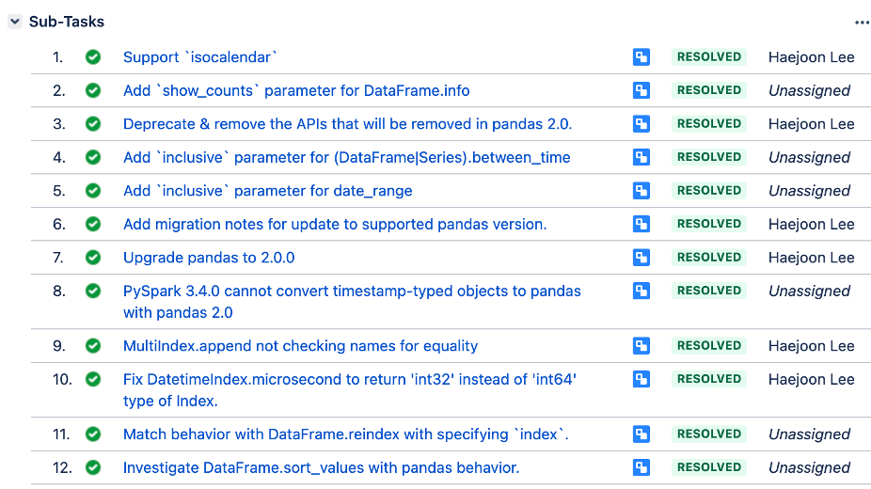
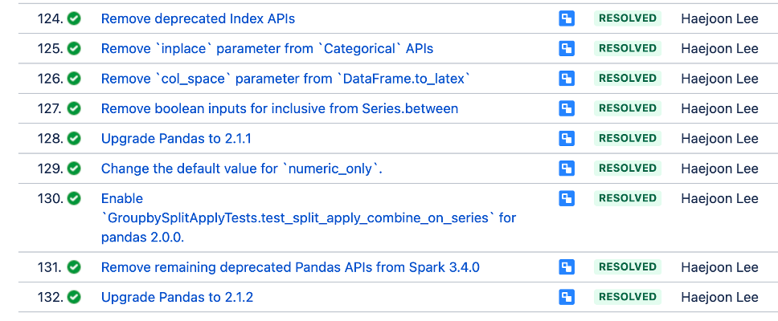
Pandas 2.x Support
API change parity with Pandas 2.2.2
Backwards incompatible API changes
Pandas 2.0.0
Pandas 2.1.0
SPARK-44101
Spark migration guide
©2024 Databricks Inc. — All rights reserved
37

Slide 38

New Functionalities
Spark Connect, ANSI Mode, Arbitrary Stateful Processing V2, Collation Support, Variant Data Types, pandas 2.x Support
Extensions
Python Data Source APIs, XML/Databricks Connectors and DSV2 Extension, Delta 4.0
Agenda
Custom Functions and Procedures
SQL UDFs, SQL Scripting, Python UDTF, Arrow optimized Python UDF, PySpark UDF Unified Profiler
Usability
Structured Logging Framework, Error Class Framework, Behavior Change Process

Slide 39
Streaming and Batching Python Data Sources
©2024 Databricks Inc. — All rights reserved

Slide 40

Why Python Data Source?
People like writing Python!
pip install is so convenient.
Simplified API without complicated performance features in Data Source V2.
Spark
Python
©2024 Databricks Inc. — All rights reserved

Slide 41
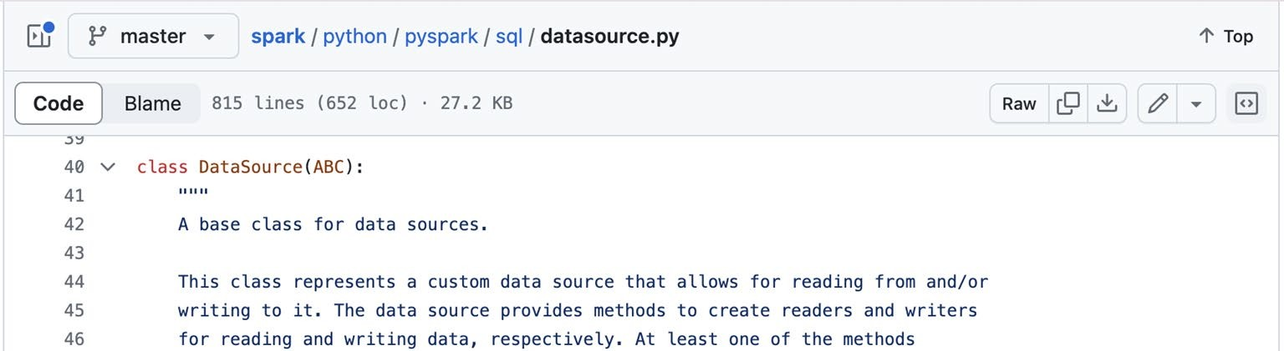
Python Data Source APIs
SPIP: Python Data Source API SPARK-44076
Available in Spark 4.0 preview version and Databricks Runtime 15.2
Support both batch and streaming, read and write
©2024 Databricks Inc. — All rights reserved

Slide 42

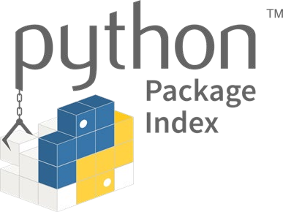


Python Data Source Overview
Easy Three Steps to create and use your custom data sources
Step 1: Create a Data Source | Step 2: Register the Data | Step 3: Read from or write to
 | Source | the data source
cLass MySource(DataSource): … | Register the data source in the current Spark session using the Python data source class: | spark.read .format("my-source") .Load(...)
 | spark .dataSource .register(MySource) | df.write .format("my-source") .mode("append") .save(...)
©2024 Databricks Inc. — All rights reserved

Slide 43
DataFrame.toArrow GroupedData.applyInArrow
©2024 Databricks Inc. — All rights reserved

Slide 44
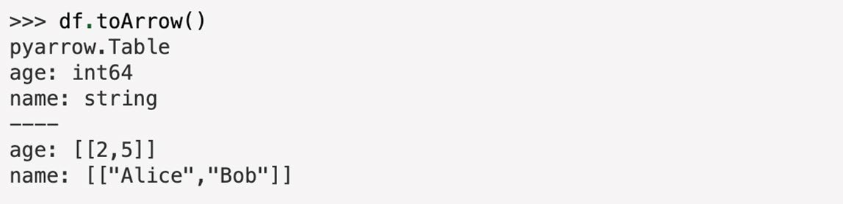
DataFrame.toArrow
An simply API to convert PySpark DataFrame to PyArrow Table.
Make it easier to integrate with Arrow ecosystem.
Note, all the data is loaded into the driver’s memory. It may cause out- of-memory errors for large data
©2024 Databricks Inc. — All rights reserved

Slide 45
GroupedData.applyInArrow
from pyspark.sql.functions import ceil
>>> import pyarrow
>>> import pyarrow.compute as pc
>>> df = spark.createDataFrame(
[(1, 1.0), (1, 2.0), (2, 3.0), (2, 5.0), (2, 10.0)], ("id", "v"))
>>> def normalize(table):
v = table.column("v")
norm = pc.divide(pc.subtract(v, pc.mean(v)), pc.stddev(v, ddof=1))
... return table.set_column(1, "v", norm)
>>> df.groupby("id").applyInArrow(
... normalize, schema="id long, v double").show()
+ + +
| id| v|
+---+-------------------+
| 1|-0.7071067811865475|
| 1| 0.7071067811865475|
| 2|-0.8320502943378437|
| 2|-0.2773500981126146|
| 2| 1.1094003924504583|
+ + +
Utilizes Apache Arrow to map functions over DataFrame groups
Returns the result as a DataFrame
Supports functions taking pyarrow.Table or tuple of grouping keys and pyarrow.Table
Note: Function requires a full shuffle and may cause out-of-memory errors for large data groups
...
...
...
...
©2024 Databricks Inc. — All rights reserved

Slide 46
XML Connectors
©2024 Databricks Inc. — All rights reserved

Slide 47
Reading XML files out of the box
spark.read.xml("/path/to/my/file.xml").show()
+ + +
| name | age |
+ + +
| | Alice | | | 23 | |
| | Bob | | | 32 | |
Python
©2024 Databricks Inc. — All rights reserved

Slide 48

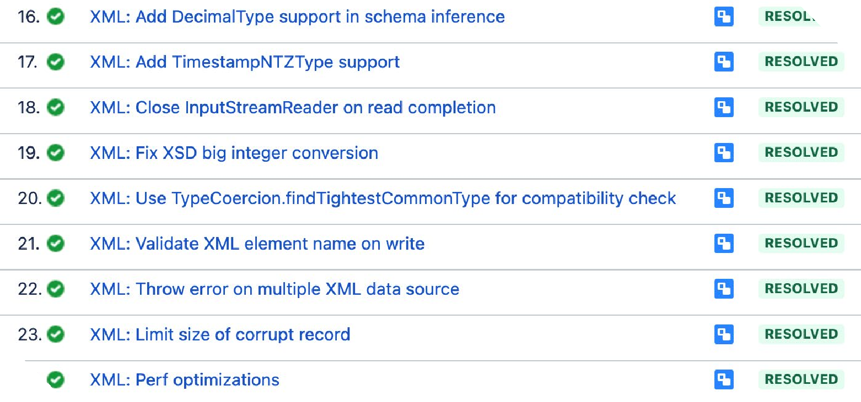

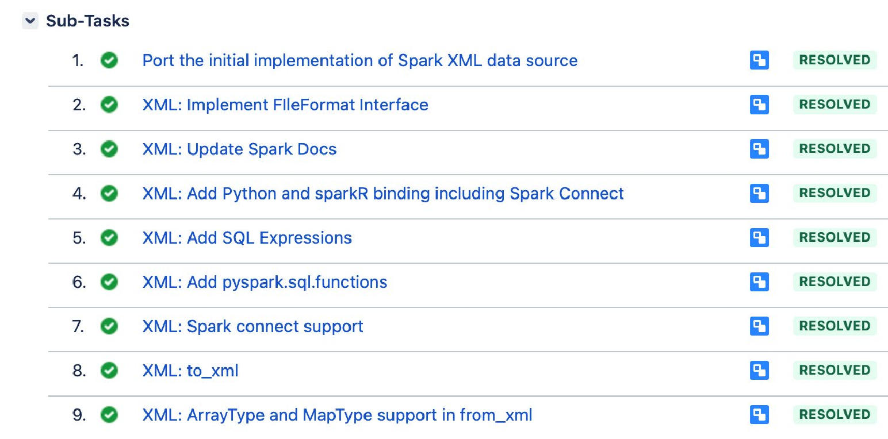
More Than Just a Simple Port
©2024 Databricks Inc. — All rights reserved

Slide 49
Databricks JDBC Dialect
©2024 Databricks Inc. — All rights reserved

Slide 50
Reading Databricks SQL out of the box
spark.read.jdbc( "jdbc:databricks://…", "my_table",
properties
).show()
+ + +
| name | age |
+ + +
| | Alice | | | 23 | |
| | Bob | | | 32 | |
Python
©2024 Databricks Inc. — All rights reserved

Slide 51
Delta Lake 4.0
©2024 Databricks Inc. — All rights reserved

Slide 52
The biggest Delta release yet
 | Delta 3.x |  |  | Delta 4.0
Deletion Vectors | Liquid clustering | Delta Kernel
Optimized Writes
VARIANT
Lightning fast semi-structured data
UniForm GA | Liquid GA | Multi-cluster writes
Write once, read as all formats | Easy migration from partitioned tables | Cross cloud, cross engines
Table features
Incremental checkpoints
Log compactions
Row IDs
Table cloning
MERGE
improvements
CDF
Auto- compaction
Delta Connect
Spark Connect support
Collations
Flexible sort and comparison
Identity columns
Pain-free primary and foreign keys
Type widening
Data types expand with your data
©2024 Databricks Inc. — All rights reserved

Slide 53








UniForm GA
Delta Lake With UniForm
Towards full
lakehouse format Interoperability
Metadata
Metadata
Data
Parquet

Slide 54
Liquid clustering Usage Walkthrough
Create a new Delta table with liquid clustering
CREATE [EXTERNAL] TABLE tbl (id INT, name STRING) CLUSTER BY(id)
Change Liquid Clustering keys on existing clustered table:
ALTER TABLE tbl CLUSTER BY (name);
Clustering data in a Delta table with liquid clustering:
OPTIMIZE tbl;
What you don’t need to worry about:
Optimal ﬁle sizes
Whether a column can be used as a clustering key
Order of clustering keys
Public doc: https://docs.databricks.com/delta/clustering.html

Slide 55
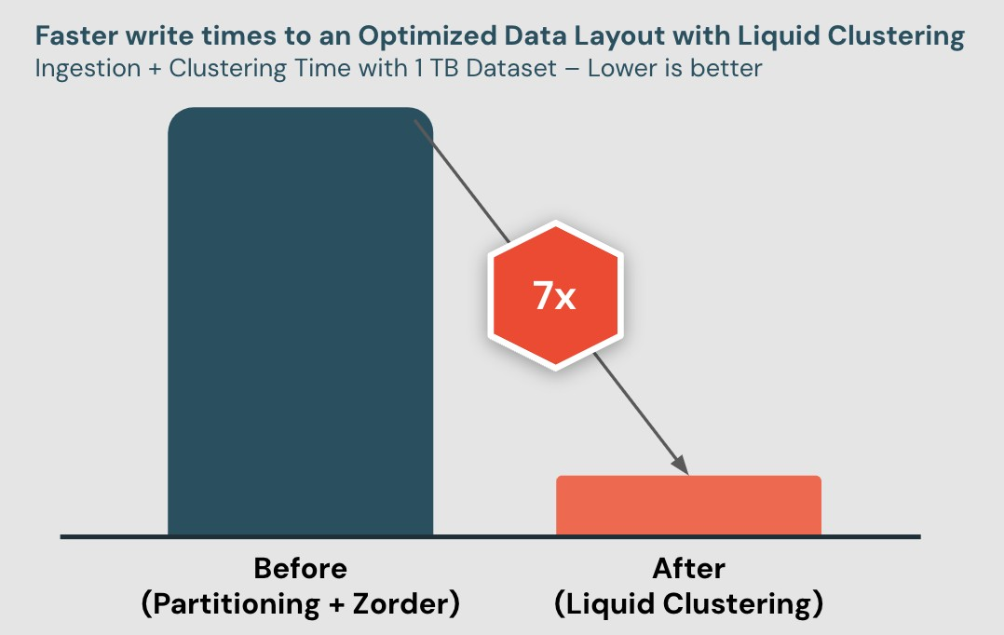
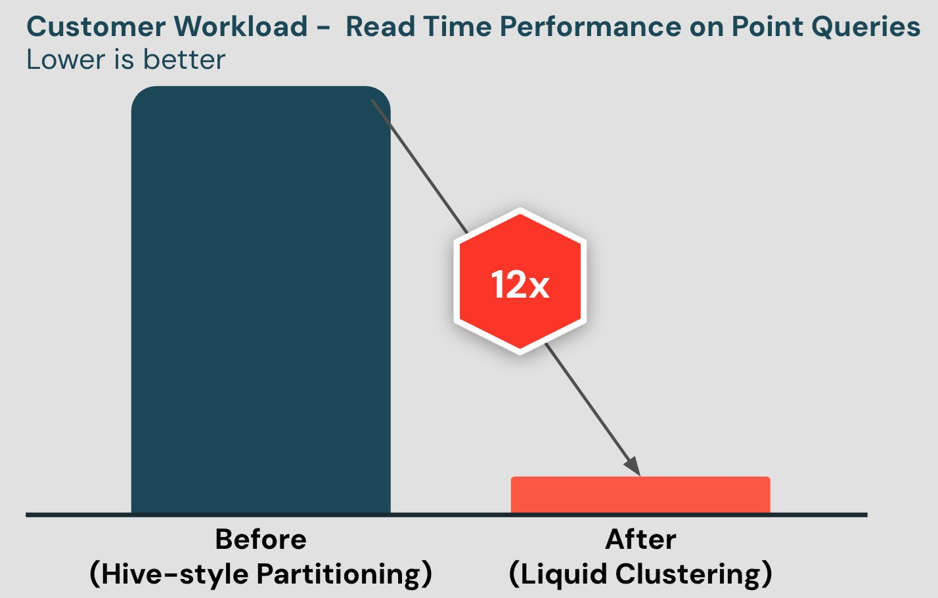
Liquid Clustering GA
Easy to use
Up to 7x faster writes Up to 12x faster reads Highly flexible

Slide 56

New Functionalities
Spark Connect, ANSI Mode, Arbitrary Stateful Processing V2, Collation Support, Variant Data Types, pandas 2.x Support
Extensions
Python Data Source APIs, XML/Databricks Connectors and DSV2 Extension, Delta 4.0
Agenda
Custom Functions and Procedures
SQL UDFs, SQL Scripting, Python UDTF, Arrow optimized
Python UDF, PySpark UDF Uniﬁed Proﬁler
Usability
Structured Logging Framework, Error Class Framework, Behavior Change Process

Slide 57
Python UDTF

Slide 58


Python User Defined Table Functions
Apache Spark 3.5
This is a new kind of function that returns an entire table as output instead of a single scalar result value
Once registered, they can appear in the FROM clause of a SQL query
Or use the DataFrame API to call them
from pyspark.sql.functions import udtf
@udtf(returnType="num: int, squared: int") class SquareNumbers:
def eval(self, start: int, end: int): for num in range(start, end + 1):
yield (num, num * num)
Python

Slide 59
Python User Defined Table Functions
Apache Spark 3.5
SELECT * FROM SquareNumbers( num => 1, squared => 3);
SquareNumbers(lit(1), lit(3)).show()
+-----+--------+
| num | squared|
+-----+--------+
+-----+--------+
| num | squared|
+-----+--------+
| | 1 | | | 1 | |
| | 2 | | | 4 | |
| | 3 | | | 9 | |
| | 1 | | | 1 | |
| | 2 | | | 4 | |
| | 3 | | | 9 | |
+-----+--------+
+-----+--------+
SQL
Python
SQL Lang
PySpark DataFrame APIs

Slide 60
Python UDTF
Apache Spark 4.0
Input Table Partitioning
Split input rows among class instances: eval
runs once each row, then terminate runs last
Polymorphic Analysis
Compute the output schema for each call depending on arguments, using analyze
class CountAndMax:
def init (self): self._count = 0
self._max = 0
def eval(self, row: Row): self._count += 1
self._max = max(self._max, row[0]) def terminate(self):
yield self._count, self._max
WITH t AS (SELECT id FROM RANGE(0, 100))
SELECT * FROM CountAndMax(
TABLE(t) PARTITION BY id / 10 ORDER BY id);
class ReadFromConfigFile: @staticmethod
def analyze(filename: AnalyzeArgument): with open(os.path.join(
SparkFiles.getRootDirectory(), filename.value), "r") as f:
# Compute the UDTF output schema
# based on the contents of the file. return AnalyzeResult(
from_file(f.read()))
...
ReadFromConfigFile(lit("config.txt")).show()
+ + +
| count | max |
+ + +
+------------+-------------+ | | | 10 | | | 0 | |
| start_date | other_field | | | | 10 | | | 1 | |
+------------+-------------+ | 2024-04-02 | 1 | | ...
Python
+------------+-------------+
Python
©2024 Databricks Inc. — All rights reserved

Slide 61
Python UDTF
Apache Spark 4.0
Custom Initialization
Create a subclass of AnalyzeResult and consume it in each subsequent init
Variable Keyword Arguments The analyze and eval methods may accept *args or **kwargs
class SplitWords: @dataclass
class MyAnalyzeResult(AnalyzeResult): numWords: int
numArticles: int
@staticmethod
def analyze(text: str): words = text.split(" ") return MyAnalyzeResult(
schema=StructType()
.add("word", StringType())
.add("total", IntegerType()), withSinglePartition=true, numWords=len(words) numArticles=len((
word for word in words
if word in ("a", "an", "the")))
class VarArgs: @staticmethod
def analyze(**kwargs: AnalyzeArgument): return AnalyzeResult(StructType(
[StructField(key, arg.dataType) for key, arg in sorted(
kwargs.items())])) def eval(self, **kwargs):
yield tuple(value for _, value in sorted(kwargs.items()))
SELECT * FROM VarArgs(a => 10, b => 'x');
+----+-----+
| a | b |
+----+-----+
| 10 | "x" |
+----+-----+ Python
def init (self, r: MyAnalyzeResult):
...
Python
©2024 Databricks Inc. — All rights reserved

Slide 62
Arrow Optimized Python UDF

Slide 63
Enhancing Python UDFs with Apache Arrow
Introduction to Arrow and Its Role in UDF Optimization:
Utilizes Apache Arrow
Supported since Spark 3.5 and ON by default since Spark 4.0
Key Beneﬁts
Enhances data serialization and deserialization speed
Provides standardized type coercion

Slide 64
Enabling Arrow Optimization
Global Activation in a UDF
Activates Arrow optimization for all Python UDFs in the Spark session
Local Activation in a UDF
Activates Arrow optimization for a specific UDF, improving performance
spark.conf.set("spark.sql.execution.pythonUDF.arro w.enabled", True)
# An Arrow Python UDF @udf(returnType='int', useArrow=True) def arrow_slen(s):
return len(s) _{Python}
# An Arrow Python UDF @udf(returnType='int') def arrow_slen(s):
return len(s)
Python

Slide 65
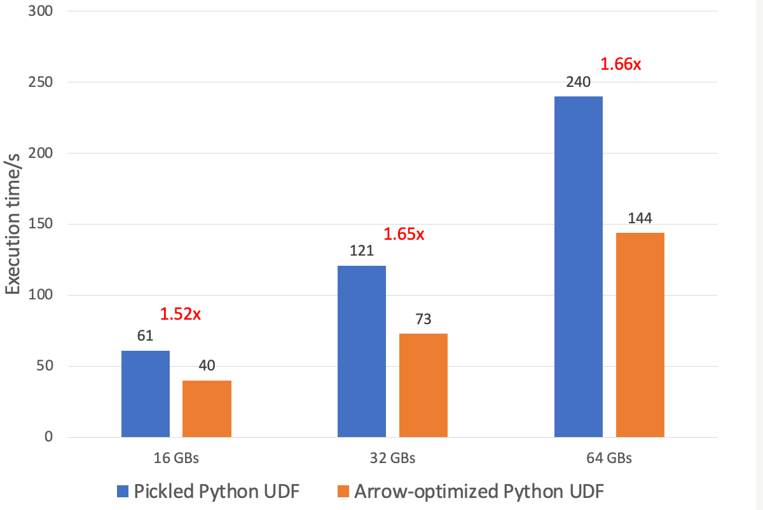
@udf(returnType='int', useArrow=True) def arrow_slen(s):
return len(s) _{Python}
Performance

Slide 66
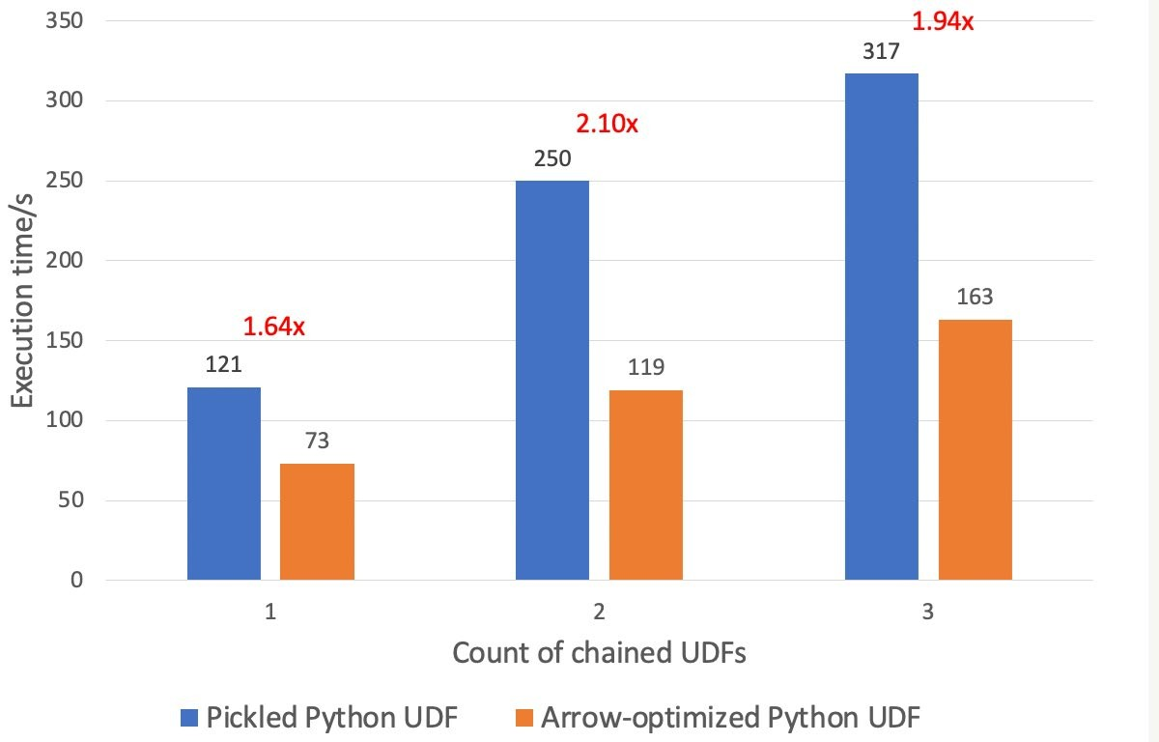
sdf.select(
udf(lambda v: v + 1, DoubleType(), useArrow=True)("v"), udf(lambda v: v - 1, DoubleType(), useArrow=True)("v"), udf(lambda v: v * v, DoubleType(), useArrow=True)("v")
)
Python
Performance

Slide 67
Pickled Python UDF
>>> + | df.select(udf(lambda | x: | x, | 'string')('value').alias('date_in_string')).show() +
| |  |  |  | date_in_string |
+ |  |  |  | +
|java.util.GregorianCalendar[time=?,areFieldsSet=false,areAllFieldsSet..|
|java.util.GregorianCalendar[time=?,areFieldsSet=false,areAllFieldsSet..|
+ +
Python
Arrow-optimized Python UDF
>>> df.select(udf(lambda x: x, 'string')('value').alias('date_in_string')).show()
+ +
|date_in_string|
+--------------+
| 1970-01-01|
| 1970-01-02|
Comparing Pickled and Arrow-optimized Python UDFs on type coercion [Link]
+--------------+
Python

Slide 68
SQL UDF / UDTF

Slide 69
Easily extend SQL function library
SQL User Defined Scalar Functions
Persisted SQL Expressions
SQL User Defined Table Functions
Persisted Parameterized Views
Support named parameter invocation and defaulting
Table functions with lateral correlation

Slide 70
SQL User Defined Scalar Functions
Encapsulate (complex) expressions, including subqueries
May contain subqueries
Return a scalar value
Can be used in most places where builtin functions go

Slide 71
SQL User Defined Scalar Functions
Persists complex expression patterns
CREATE FUNCTION roll_dice(
num_dice INT DEFAULT 1 COMMENT 'number of dice to roll (Default: 1)’, num_sides INT DEFAULT 6 COMMENT 'number of sides per die (Default: 6)'
) COMMENT 'Roll a number of n-sided dice’ RETURN aggregate(
sequence(1, roll_dice.num_dice, 1),
0,
(acc, x) -> (rand() * roll_dice.num_sides) :: INT, acc -> acc + roll_dice.num_dice
);
SELECT roll_dice(); 3
-- Roll 3 6-sided dice
SELECT roll_dice(3); 15
-- Roll 3 10-sided dice
SELECT roll_dice(3, 10) 21
SQL
©2024 Databricks Inc. — All rights reserved

Slide 72
SQL User Defined Table Functions
Encapsulate (complex) correlated subqueries aka a parameterized view
Can be used in the FROM clause

Slide 73
SQL User Deﬁned Table Functions
Persist complex parameterized queries
CREATE FUNCTION weekdays(start DATE,end DATE) RETURNS TABLE(day_of_week STRING, day DATE) RETURN SELECT
to_char(day, 'E’), day
FROM (
SELECT sequence(weekdays.start, weekdays.end)
) AS t(days), LATERAL(explode(days)) AS dates(day) WHERE
extract(DAYOFWEEK_ISO FROM day) BETWEEN 1 AND 5;
SQL

Slide 74
SQL User Defined Table Functions
Persist complex parameterized queries
SELECT
day_of_week, day
FROM
weekdays(DATE '2024-01-01’,
DATE '2024-01-14’);
-- Return weekdays for date ranges originating from a LATERAL correlation
SELECT
weekdays.* FROM
VALUES
(DATE '2020-01-01’),
(DATE '2021-01-01') AS starts(start),
LATERAL weekdays(start, start + INTERVAL '7' DAYS);
Mon
… Fri Mon
2022-01-01
2022-01-05
2022-01-08
Wed | 2020-01-01
Thu | 2020-01-02
Fri | 2020-01-03
…
SQL
SQL

Slide 75
Named parameter invocation
Self documenting and safer SQL UDF invocation
DESCRIBE FUNCTION roll_dice; Function: default.roll_dice Type: SCALAR
Input: num_dice INT
num_sides INT Returns: INT
-- Roll 1 10-sided dice - skip dice count
SELECT roll_dice(num_sides => 10) 7
-- Roll 3 10-sided dice - reversed order
SELECT roll_dice(num_sides => 10, num_dice => 3) 21
SQL

Slide 76
Stored Procedure

Slide 77

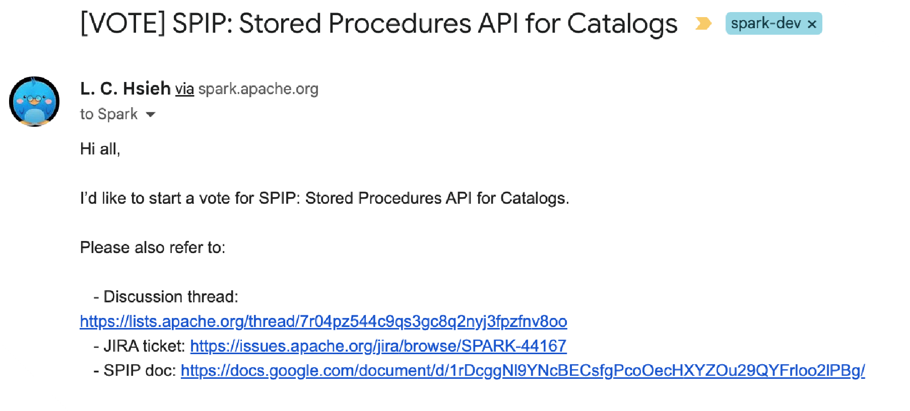
External Stored Procedures

Slide 78

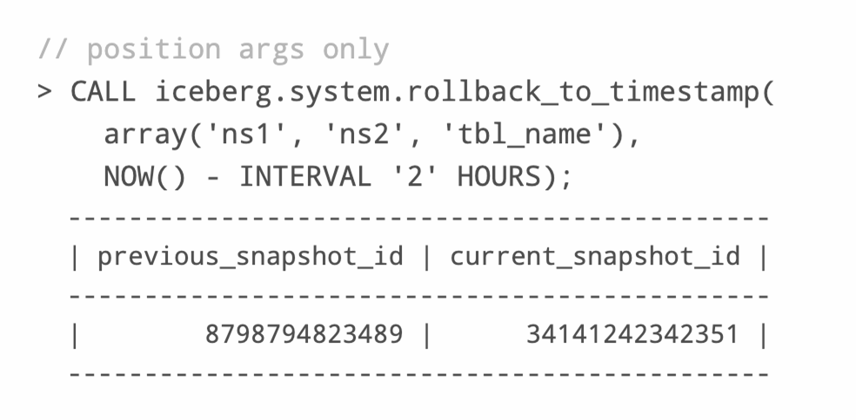
External Iceberg Stored Procedure

Slide 79
SQL Scripting
It’s SQL, but with control flow!
Support for control flow, iterators & error handling Natively in SQL
Control flow → IF/ELSE, CASE
Looping → WHILE, REPEAT, ITERATE
Resultset iterator → FOR
Exception handling → CONTINUE/EXIT
Parameterized queries → EXECUTE IMMEDIATE
Following the SQL/PSM standard

Slide 80
SQL Scripting
BEGIN
DECLARE c INT = 10; WHILE c > 0 DO
INSERT INTO t VALUES (c); SET VAR c = c - 1;
END WHILE; END
SQL

Slide 81
SQL Scripting
WHILE i < array_size(tableArray) DO SET
tableType = ( SELECT
table_type FROM
INFORMATION_SCHEMA.tables WHERE
table_name = tableArray [i]
);
IF tableType != 'VIEW' COLLATE UNICODE_CI THEN SET
alterQuery = 'ALTER TABLE ' || tableArray [i] || ' RENAME COLUMN ' || oldColName || ' TO ' || newColName;
EXECUTE IMMEDIATE alterQuery; END IF;
SET i = i + 1; END WHILE;
END;
SQL
-- parameters
DECLARE oldColName = 'ColoUr'; DECLARE newColName = 'color’;
BEGIN
DECLARE tableArray Array < STRING >; DECLARE tableType STRING;
DECLARE i INT = 0;
DECLARE alterQuery STRING; SET
tableArray = ( SELECT
array_agg(table_name) FROM
INFORMATION_SCHEMA.columns WHERE
column_name
COLLATE UNICODE_CI = oldColName
);

Slide 82
PySpark UDF Unified Profiling

Slide 83
Overview of Uniﬁed Proﬁling
Key Components: Performance and memory profiling
Benefits: Tracks function calls, execution time, memory usage
Replacement for Legacy Profiling
Drawbacks of Legacy Profiling
Advantages of New Unified Profiling
Session-based, works with Spark Connect, runtime toggling

Slide 84
Overview of Unified Profiling
How to Enable:
Performance Proﬁler: spark.conf.set("spark.sql.pyspark.udf.proﬁler", "perf")
Memory Proﬁler: spark.conf.set("spark.sql.pyspark.udf.proﬁler", "memory")
API Features: "show", "dump", and "clear" commands
Show results:
Performance: spark.proﬁle.show(type="perf")
Performance: spark.proﬁle.show(type="memory")
Dump results: spark.proﬁle.dump("/your_path/...")
Clear results: spark.proﬁle.clear()

Slide 85
PySpark Performance Profiler
from pyspark.sql.functions import pandas_udf
df = spark.range(10) @pandas_udf("long") def add1(x):
return x + 1
added = df.select(add1("id"))
spark.conf.set("spark.sql.pyspark.udf.profiler", "perf") added.show()
Python

Slide 86
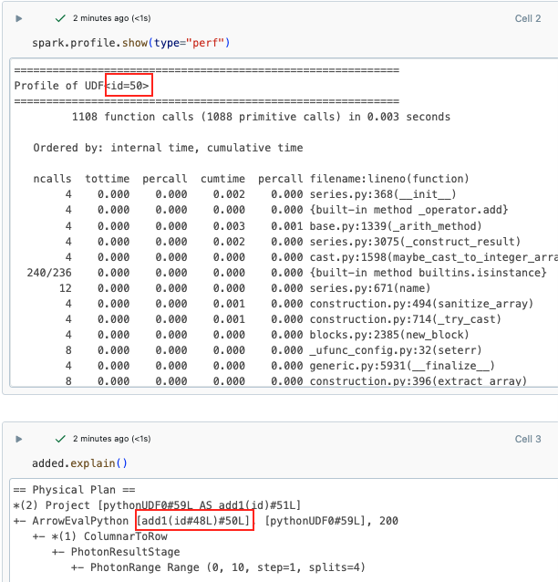
PySpark Performance Proﬁler

Slide 87
PySpark Memory Profiler
from pyspark.sql.functions import pandas_udf
df = spark.range(10) @pandas_udf("long") def add1(x):
return x + 1
added = df.select(add1("id"))
spark.conf.set("spark.sql.pyspark.udf.profiler", "memory") added.show()
Python

Slide 88
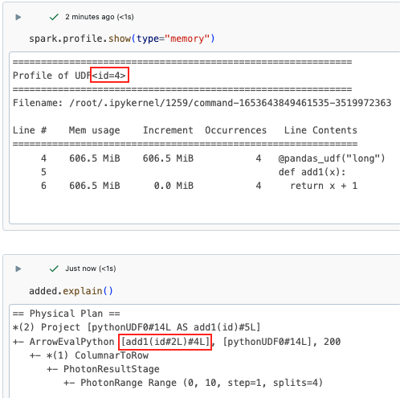
PySpark Memory Profiler

Slide 89

New Functionalities
Spark Connect, ANSI Mode, Arbitrary Stateful Processing V2, Collation Support, Variant Data Types, pandas 2.x Support
Extensions
Python Data Source APIs, XML/Databricks Connectors and DSV2 Extension, Delta 4.0
Agenda
Custom Functions and Procedures
SQL UDFs, SQL Scripting, Python UDTF, Arrow optimized
Python UDF, PySpark UDF Uniﬁed Proﬁler
Usability
Structured Logging Framework, Error Class Framework, Behavior Change Process

Slide 90
Structured Logging Framework
©2024 Databricks Inc. — All rights reserved

Slide 91


What are we going to build to improve this?
Transition to Structured Logging in Apache Spark
Introducing Spark System Log Directories
©2024 Databricks Inc. — All rights reserved
91

Slide 92

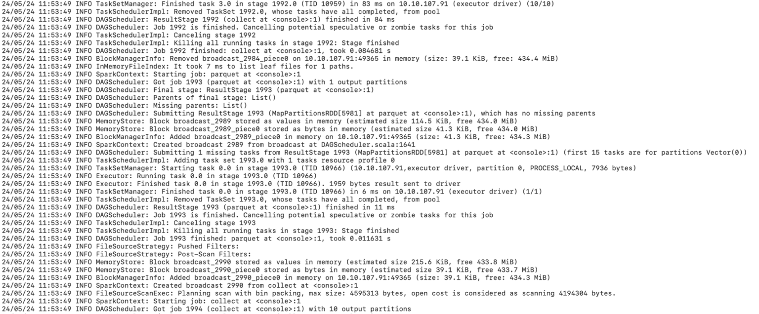
Analyzing Spark logs is challenging due to their unstructured nature

Slide 93
Structured Spark Logging
Starting from Spark 4.0, the default log format is JSON lines, making it easier to parse and analyze.
{
"ts": "2023-03-12T12:02:46.661-0700",
"level": "ERROR",
"msg": "Fail to know the executor 289 is alive or not", "context": {
"executor_id": "289"
},
"exception": {
"class": "org.apache.spark.SparkException", "msg": "Exception thrown in awaitResult", "stackTrace": "..."
},
"source": "BlockManagerMasterEndpoint"
}
Json

Slide 94
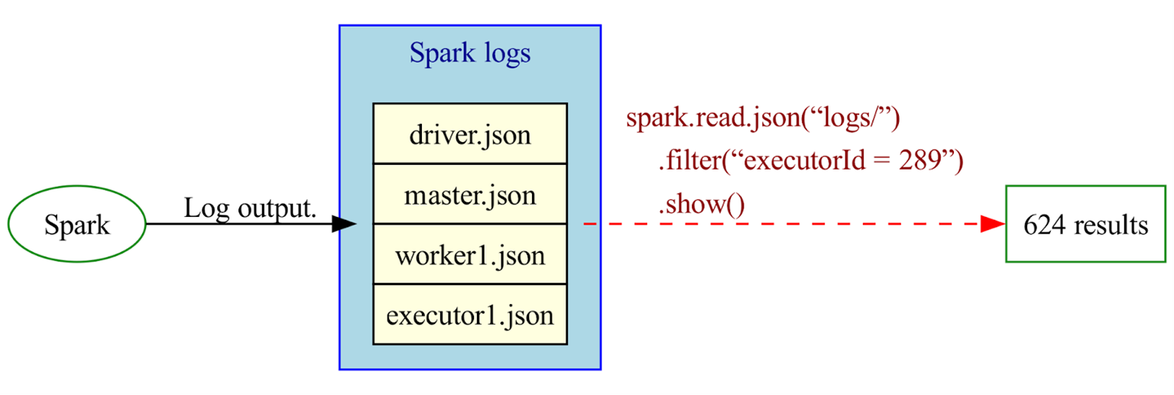
Use Spark to Analyze Spark Logs

Slide 95
System Log Directories
logs = spark.read.json("/var/spark/logs.json")
# To get all the errors on host 100.116.29.4
errors_host_logs = logs.filter(
(col("context.host") == "100.116.29.4") & (col("level") == "ERROR"))
# To get all the exceptions from Spark
spark_exceptions_logs = logs.filter(
col("exception.class").startswith("org.apache.spark"))
Python

Slide 96
System Log Directories
logs = spark.read.json("/var/spark/logs.json")
# To get all the executor loss logs executor_lost_logs = logs.filter(
col("msg").contains("Lost executor"))
# To get all the distributed logs about executor 289 executor_289_logs = logs.filter(
col("context.executor_id") == 289)
Python

Slide 97
Error Conditions and Messages

Slide 98
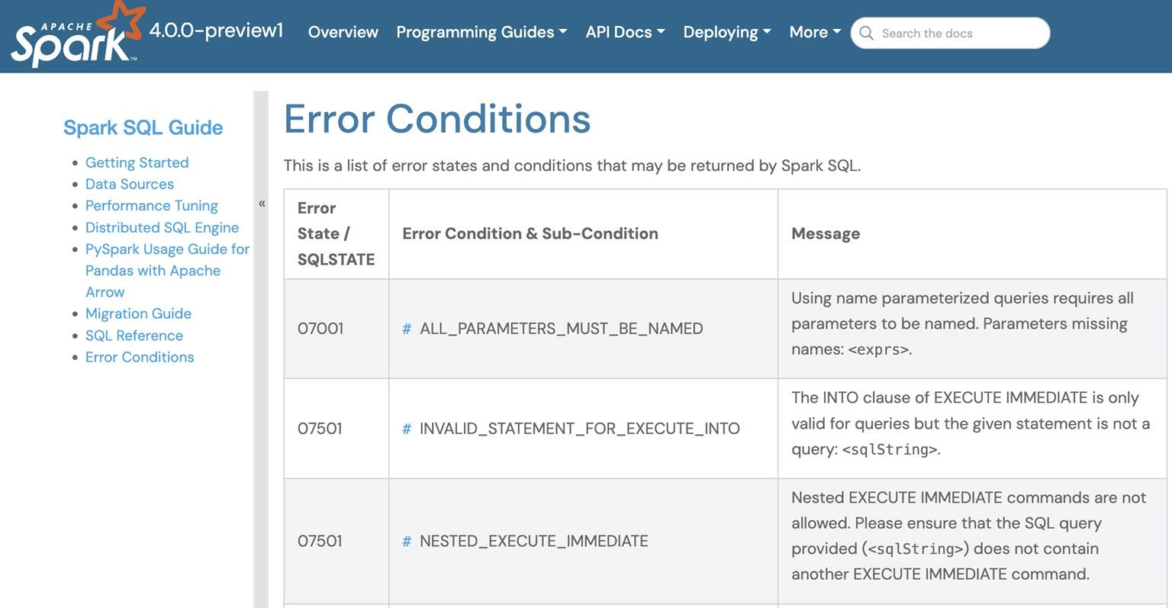
Error Conditions
800+ top-frequency error conditions from the server.

Slide 99
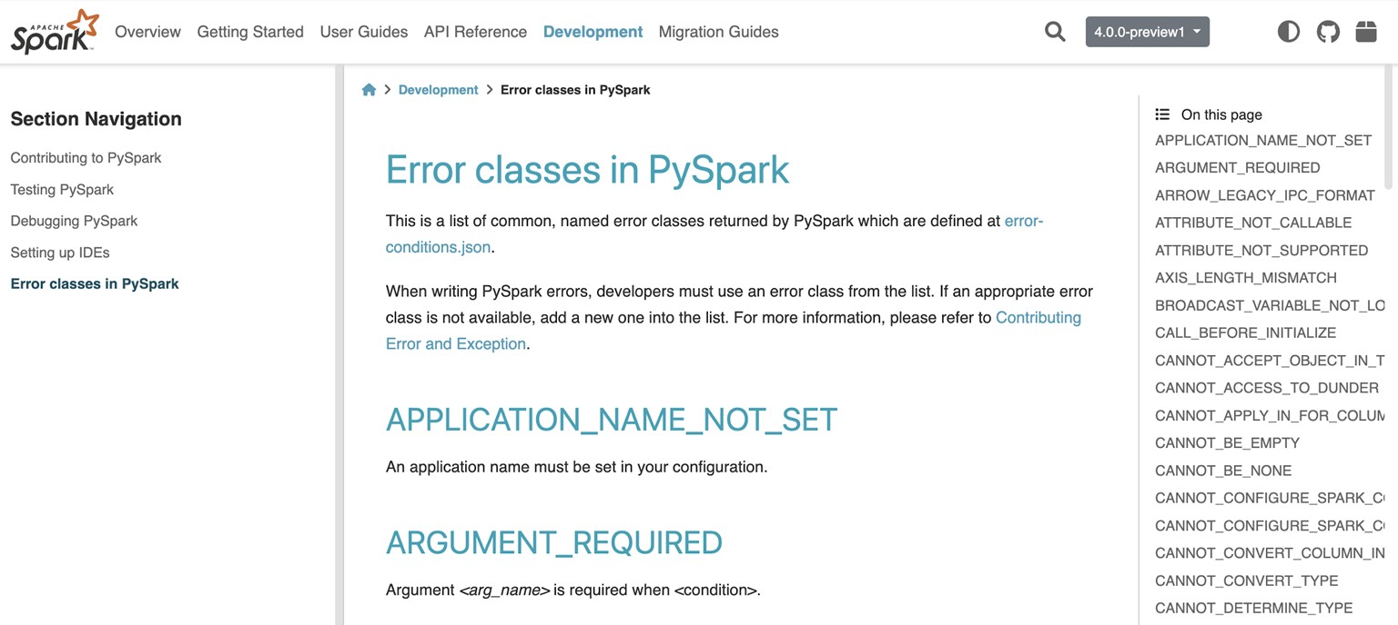
Error Conditions in PySpark
All 200+ error conditions issued by PySpark client

Slide 100
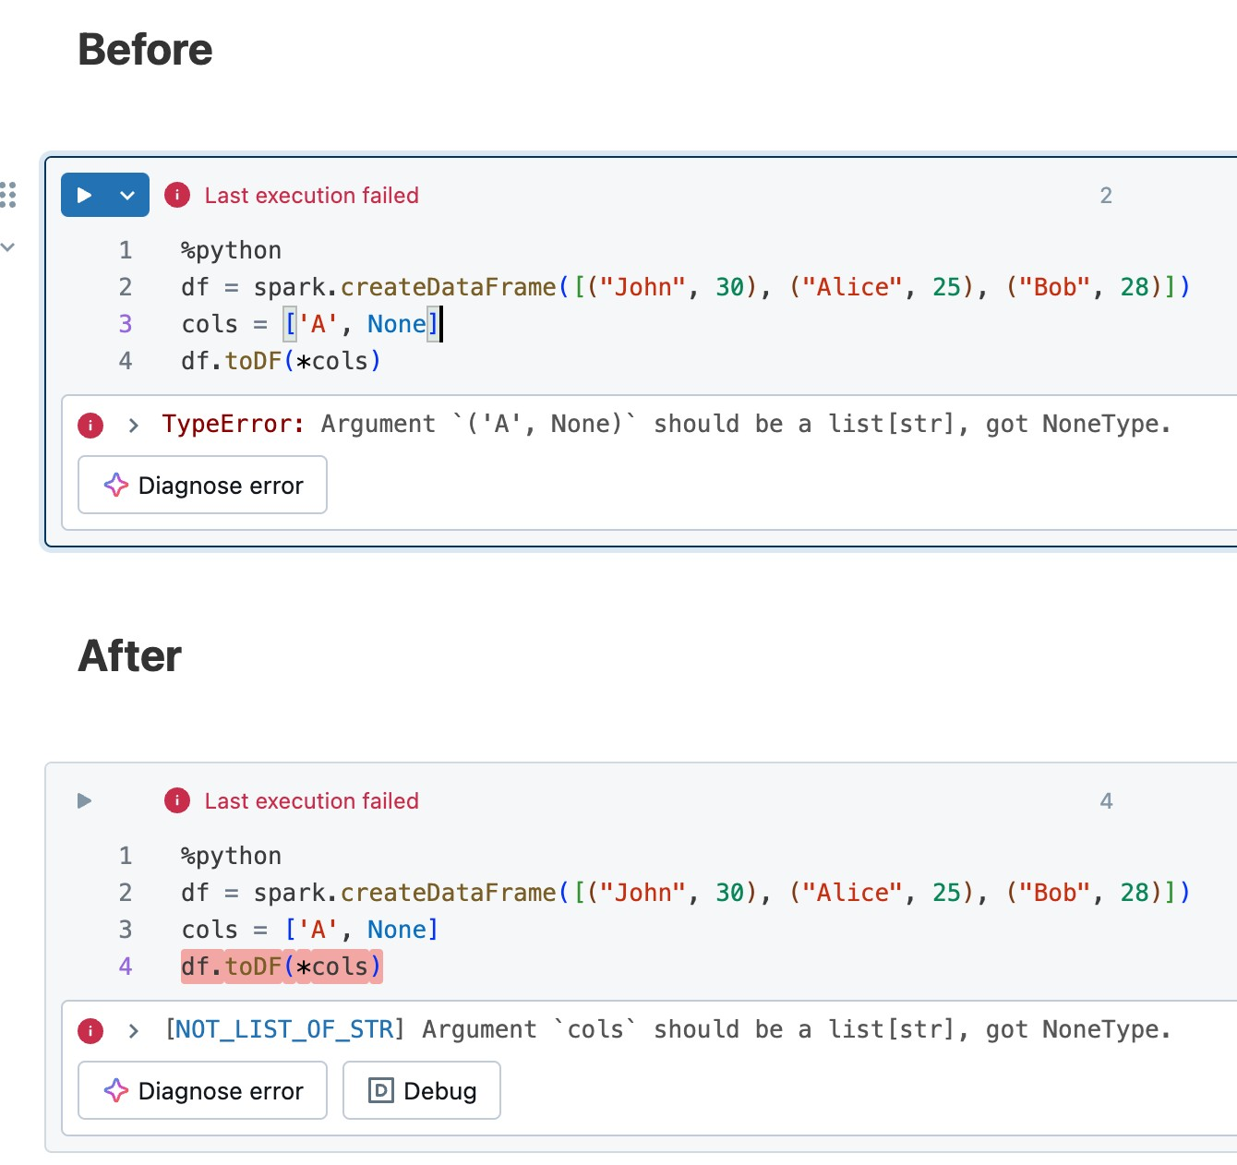
Quality
PySpark Errors
Clear and speciﬁc error
classes
Improved documentation
Consistency and standardization
Enhanced debugging and maintenance

Slide 101
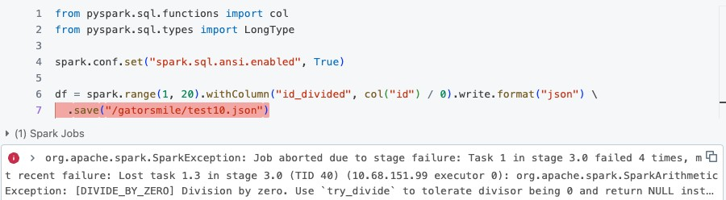
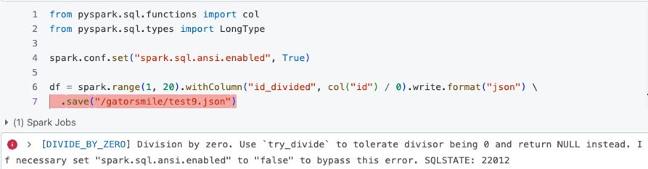
Spark 3.5
Spark 4.0

Slide 102
Behavior Changes

Slide 103
Overview of Apache Spark Versioning Policy
Semantic Versioning Structure: [MAJOR].[FEATURE].[MAINTENANCE]
MAJOR: Long-term API stability
FEATURE: New features and improvements
MAINTENANCE: Frequent, urgent patches
API Compatibility Commitments: Maintain compatibility across feature releases, reducing the need for users to refactor code.

Slide 104
Categories of Impactful Behavior Changes
Query Results Impact: Changes affecting the accuracy and outcome of data queries.
Schema and Configuration Changes: Adjustments to the database or application schema and Spark configuration settings.
API Modifications: Alterations to the public and developer APIs across multiple programming languages.
Error Handling Adjustments: Modifications in how errors are classified and handled within the system.
Deployment and Management Revisions: Changes in the methods and tools used for deploying and managing Spark environments.

Slide 105
Best Practices for API Changes
General Approach:
Avoid API changes whenever possible.
Prefer deprecating features over direct modiﬁcations to ensure smoother
transitions.
Implement legacy ﬂags to allow users to opt into previous behaviors
temporarily, easing the transition to new versions.
Communicate changes clearly through deprecation warnings and documentation updates.

Slide 106
Best Practices for API Changes
User-facing documentation
Migration Guide Updates: Regularly update the migration guide with detailed information on changes affecting user operations.
Legacy Configs: Include information on legacy configurations that might help users transition smoothly between versions.
Error Messages:
Clarity and Actionability: Ensure that all error messages are clear and direct, informing the user precisely what went wrong.
Workarounds: Wherever possible, provide actionable advice within the error message, including configuration changes that can revert to previous behaviors or other immediate solutions.

Slide 107
Best Practices for API Changes
PR Descriptions
Detail: Provide comprehensive explanations of the changes, highlighting the
modiﬁcations and their implications.
Transparency: Explain clearly how the new behavior differs from the old, and the reasons for these changes.

Slide 108
Documentation

Slide 109
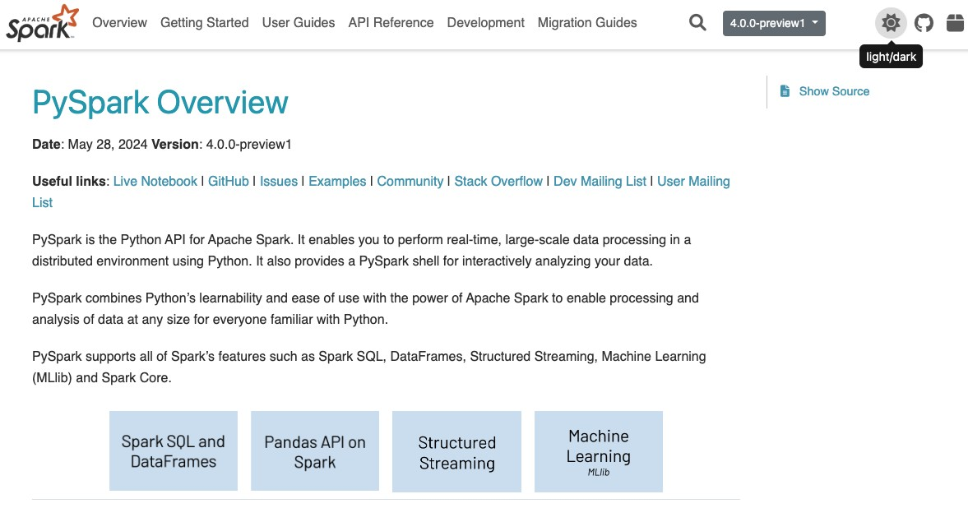
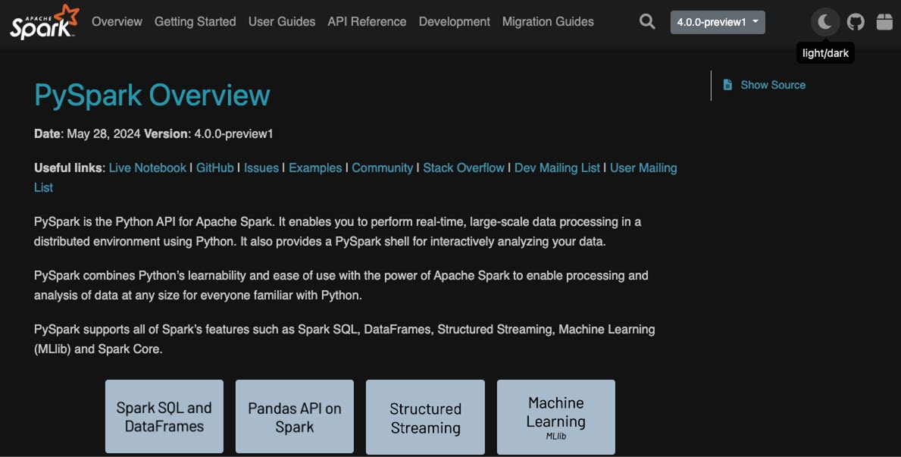
PySpark Doc – Dark Mode

Slide 110

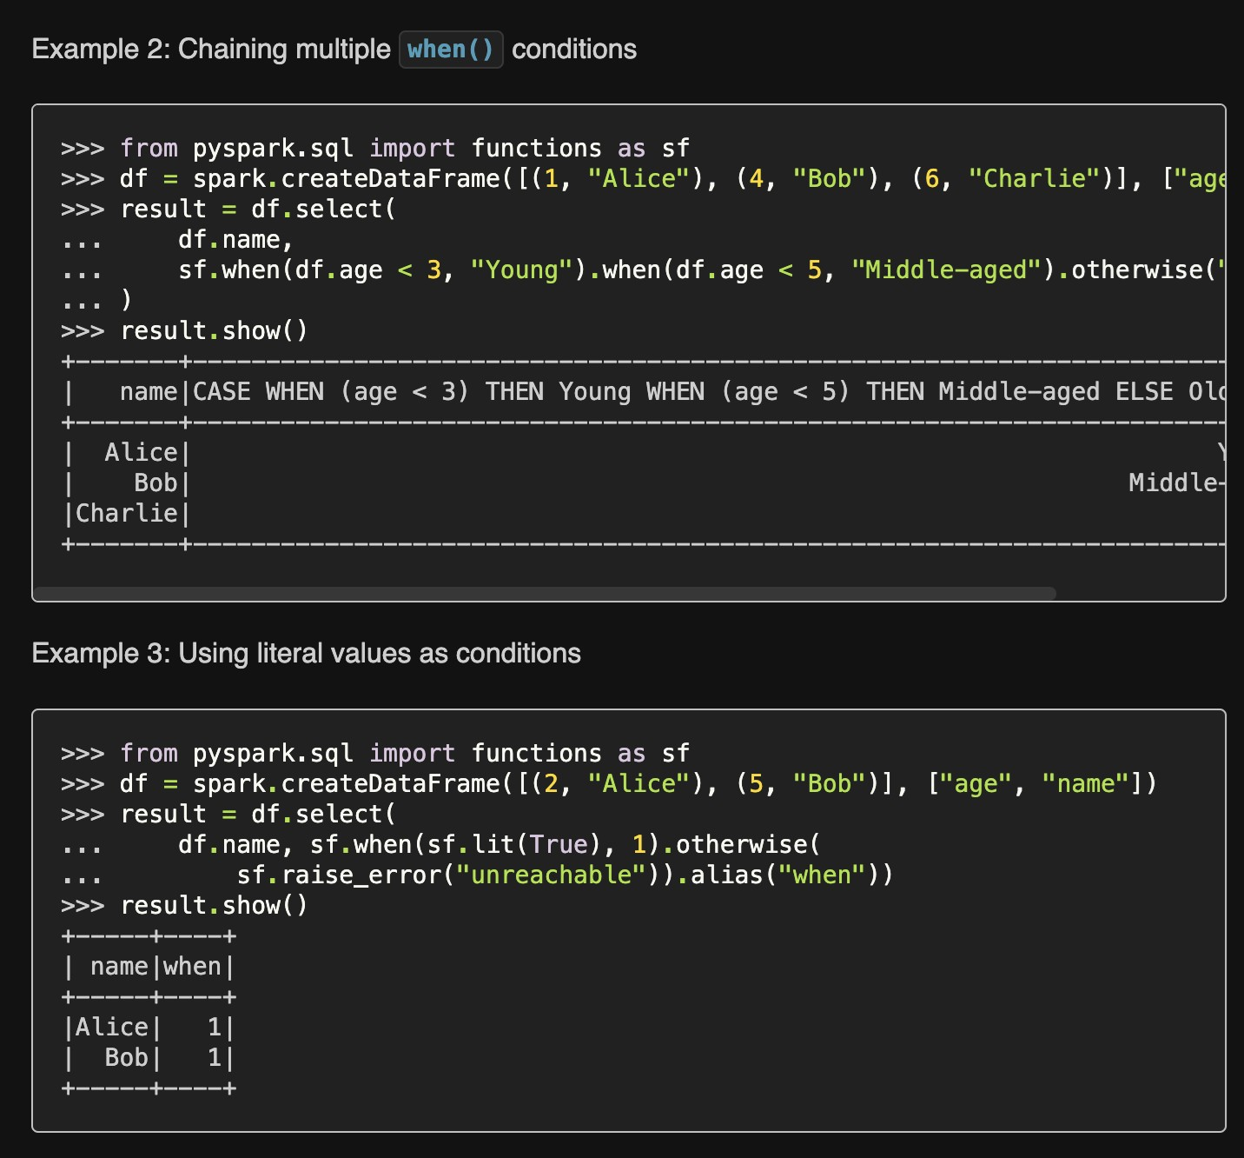
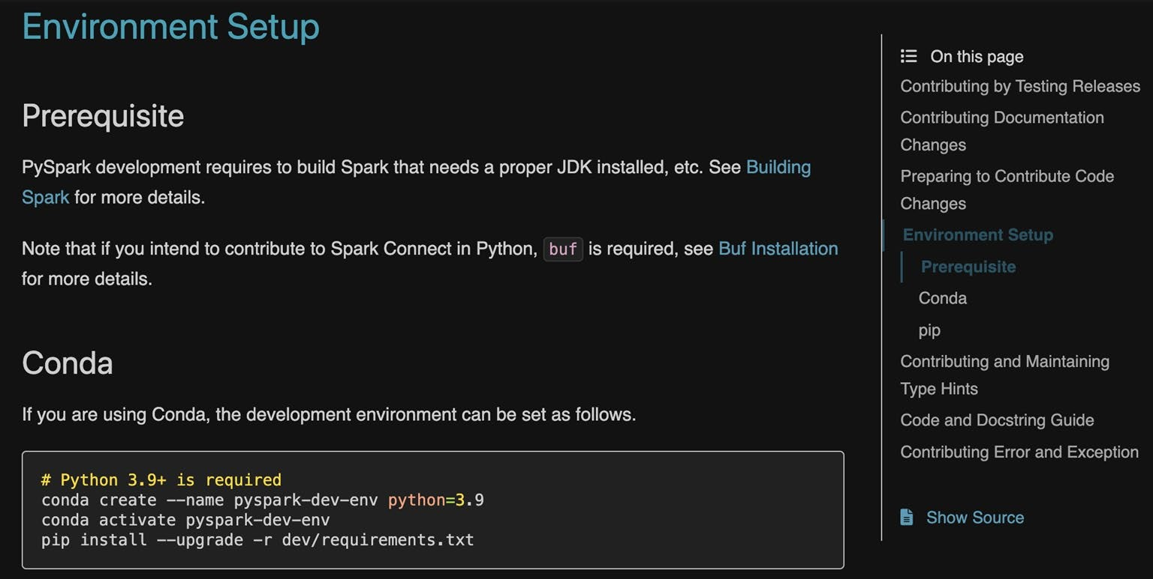
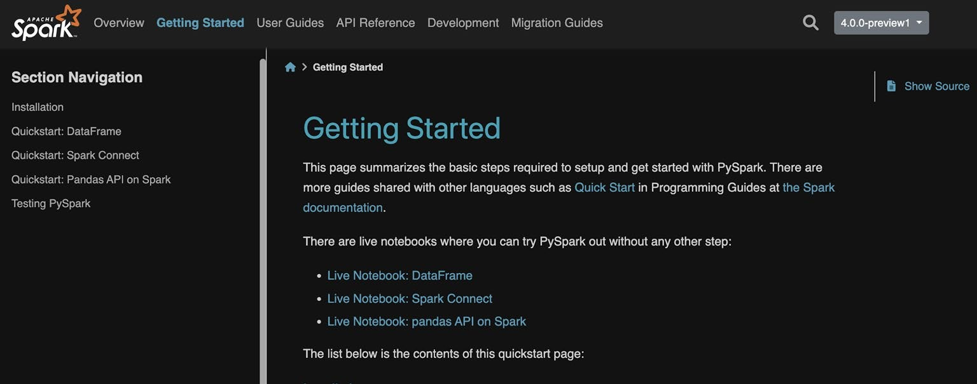
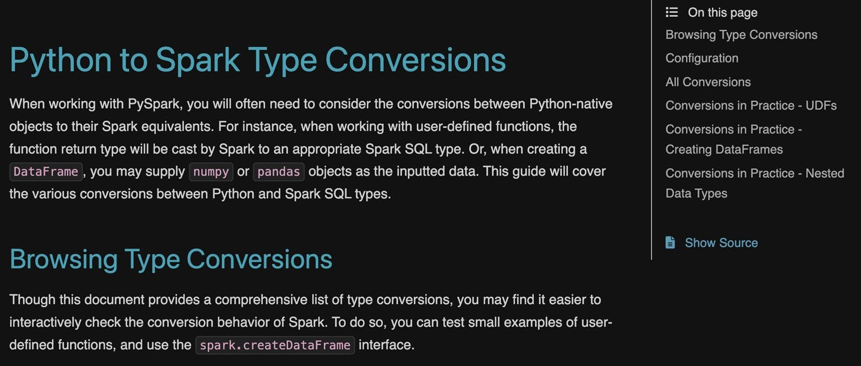
PySpark Doc
SPARK-44728
More examples
Environment Setup
Quickstart
Type System

Slide 111
Versionless Spark Programming Guide

Slide 112

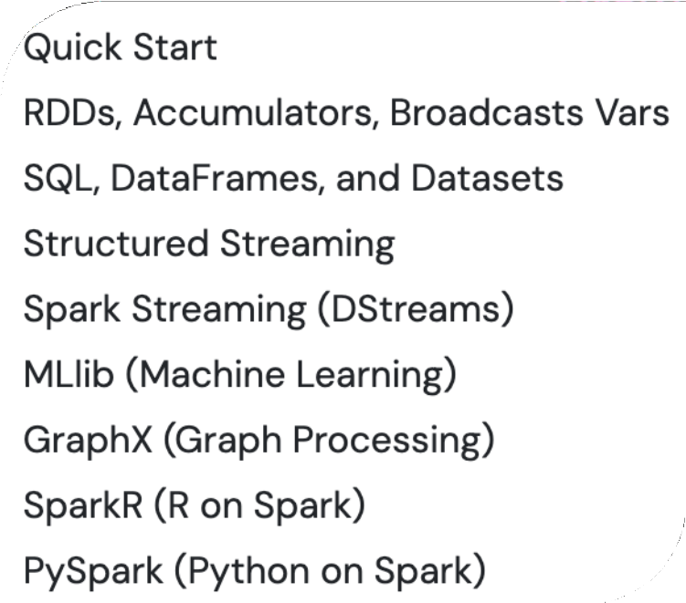
[Proposal] Versionless Spark Programming Guide
Motivation: Allow for real-time updates and rapid content iteration without release schedule constraints.
Small changes pose less SEO deranking risk than major updates.
Transition 9 existing programming guides to Spark website repo.

Slide 113

Python: The Number One Choice

Slide 114
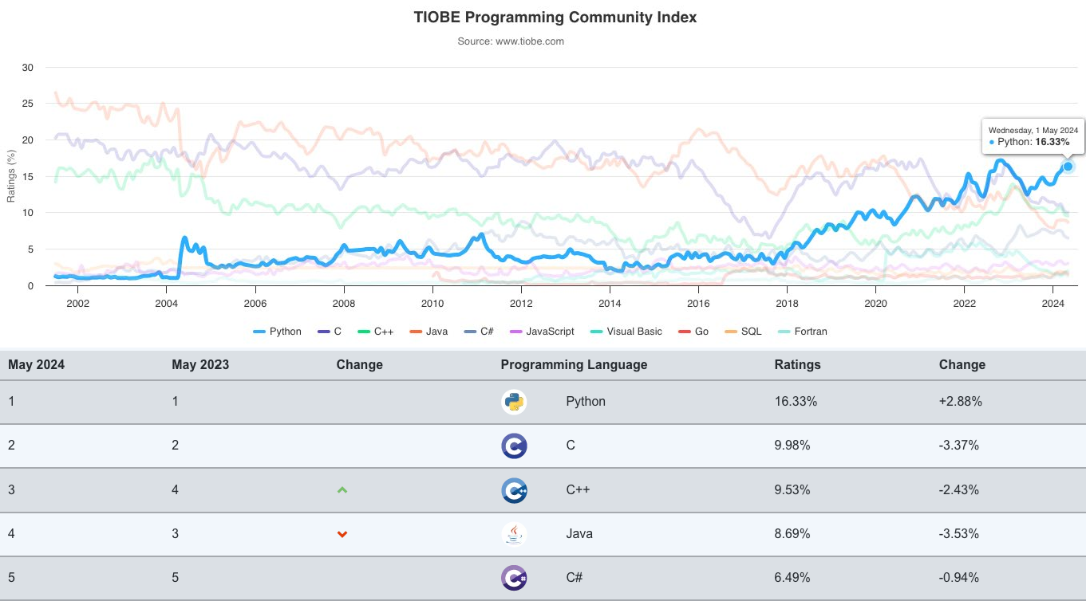

Slide 115

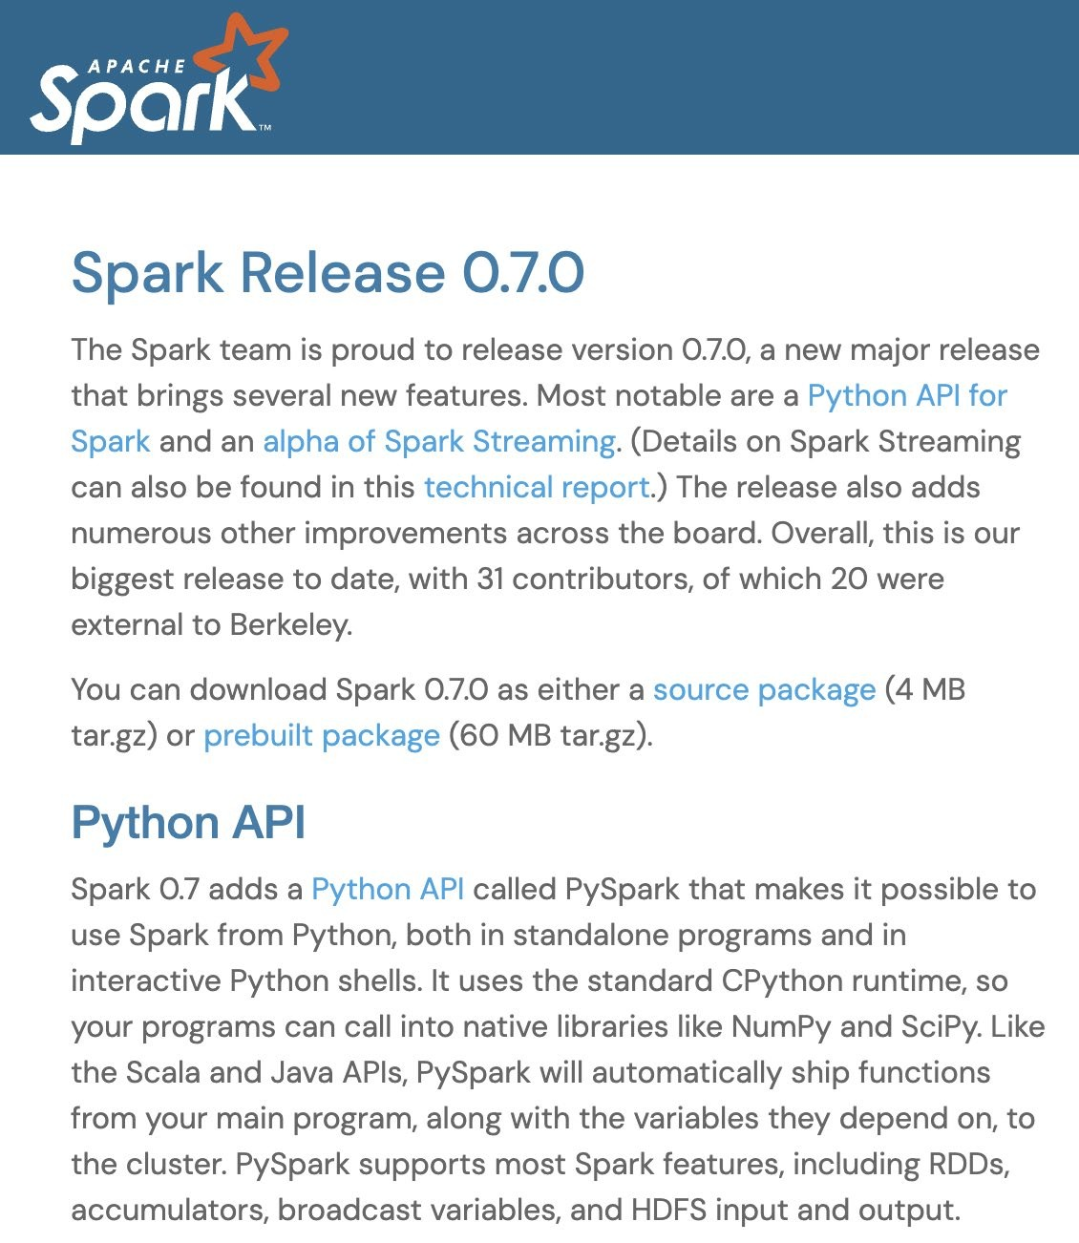
Birth of PySpark
2013

Slide 116

>330
millions
Number of PyPI Downloads per Year

Slide 117

Countries and Regions
PyPI downLoads of PySpark
in the Last 12 months

Slide 118

PySpark’s View of the World
DataFrame APIs
SQL
pandas APIs
PySpark
Catalyst Optimizer
Adaptive Execution
Spark Ecosystem (connectors, 3rd party libraries)

Slide 119
Key Focus of PySpark
Functionality Parity
Complete feature availability
Python native APIs
Performance Parity
Matched Performance with Scala
Optimized query compiler and engine
Ease of Use
No JVM Knowledge Required
Pythonic APIs
Ecosystem Integration
Integrated with Python ecosystem
Spark ecosystem growth

Slide 120
Key Enhancements in PySpark 3.5 and 4.0
Functionality Parity
180 new built-in functions in Spark 3.5+
Python native data source APIs
Stateful streaming processing V2
Python UDTFs
Performance
Spark Connect
Arrow-optimized Python UDF
Variant type for semi-structured processing
Advanced optimizer and adaptive execution
Ease of Use
Spark Connect
Error Framework
Enriched Documentation
Unified UDF profiling
Ecosystem Integration
Compatible with pandas 2 (pandas API)
Delta Lake 4.0
[ML] Distributed training with TorchDistributor
Arrow integration: toArrow API

Slide 121




















UDF-level Dependency Control [WIP]
Python UDF Memory/CPU Profiler
Pandas 2 Compatibility
pandas API on Spark Coverage
NumPy Inputs
applyInArrow
180+
New Python Functions
Spark Connect
mapInArrow
Deepspeed Distributor
PySpark
Visualization/ Plotting
Richer Connectors
Pythonic Error Handling
[WIP] DF / UDF
Debuggability
Arrow-optimized Python UDFs
DF.toArrow()
Python Arbitrary Stateful Processing
Type Annotations
Python UDTF
PySpark Testing API

Slide 122




Thank you for your contributions!

Slide 123

©2024 Databricks Inc. — All rights reserved

